Slide 1
Chapter 15
Physical and
Hardware Security

Slide 2
Objectives
Explain the function of hardware and software security devices
Explain common features of a firewall
Explain issues that affect device security

Slide 3
Using Hardware and Software
Security Devices
In medium to large enterprise networks, strategies for security usually include some combination of internal and perimeter routers plus firewall devices. Internal routers provide added security by screening traffic to the more vulnerable parts of a corporate network though a wide array of strategic access lists.

Slide 4
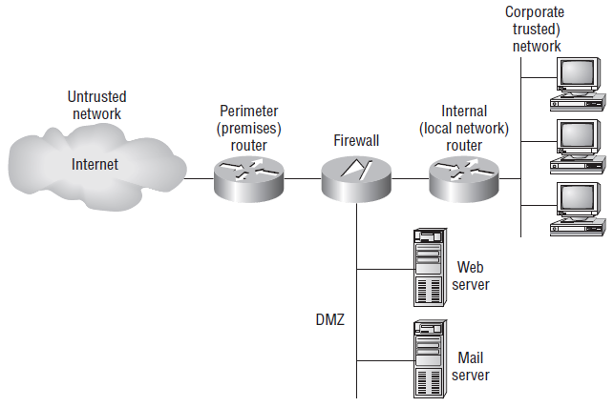
Using Hardware and Software
Security Devices (contd…)
A typical secured network

Slide 5
Defining Firewalls
Firewalls can be placed on top of an existing operating system or be self-contained. Conversely, black-box systems are proprietary and have external controls that aren’t controlled by the operating system itself. If you opt to use a general-purpose server operating system to run your firewall, you can do that with Unix and Windows because both of these support third-party firewall products.

Slide 6
Firewall Technologies
Things like access control lists and dynamic packet filtering are often used as firewalls in their own right, or they can be implemented along with proxies and DMZs and other firewall technologies to build a serious, formidable system fortress.

Slide 7
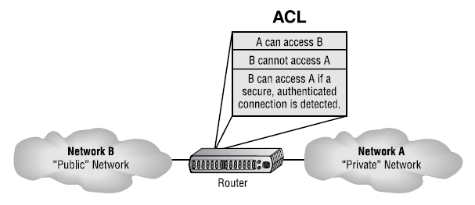
Firewall Technologies- Access Control Lists (ACL)
The first line of defense for any network that’s connected to the Internet is what we call access control lists (ACLs). These reside on your routers and determine by IP addresses which machines are allowed to use those routers and in what direction. ACLs have been around for decades and have some other really cool uses apart from firewalls.

Slide 8
Firewall Technologies- Access Control Lists (ACL) (contd…)
There are two main types of ACLs:
  Standard ACLs: These use only the source IP address in an IP packet as the condition test, so all decisions regarding a packet will be based on the source IP address.
  Extended ACLs: Extended ACLs go the distance and evaluate lots of the other fields in the Layer 3 and 4 headers of an IP packet. They can evaluate source and destination IP addresses, the protocol field in the Network layer header, and the port number at the Transport layer header.

Slide 9
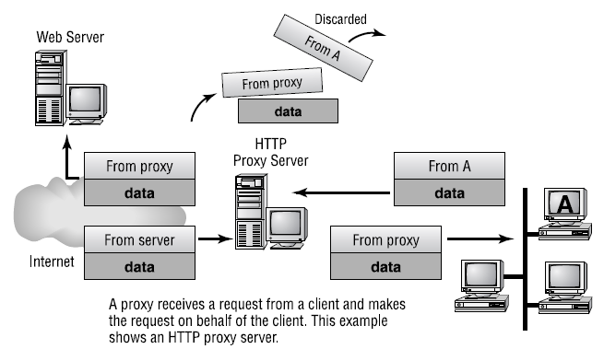
Proxy Services
Firewalls can also implement something called proxy services, which actually makes them proxy servers, or proxies for short. Proxies act on behalf of the whole network to completely separate packets from internal hosts and external hosts.

Slide 10
Stateful vs. Stateless Network-Layer Firewalls
A basic packet filter doesn’t care about whether the packet it is examining is stand-alone or part of a bigger message stream. That type of packet filter is said to be stateless, in that it does not monitor the status of the connections passing through it. Again, these work pretty well, but the firewall has no idea whether a packet is legitimate or possibly a rogue packet trying to sneak by. These types of firewalls tended to be susceptible to various DoS attacks and IP spoofing.

Slide 11
Scanning Services and Other
Firewall Features
Firewalls can scan incoming HTTP traffic to look for viruses or spyware, or scan email looking for spam. You can often set scanning rules that will prevent users from downloading large files over a certain size. On Cisco routers, scanning is administered by the Content Security Control (CSC) and Security Services Module (SSM). Two categories of content are typically scanned: mail and web.

Slide 12
Signature Identification
Firewalls can also stop attacks and problems through a process called signature identification. Viruses that are known will have a signature, which is a particular pattern of data, within them. Firewalls (and antivirus programs) can use signatures to identify a virus and remove it. The same holds true for other software bugs such as worms and spyware.

Slide 13
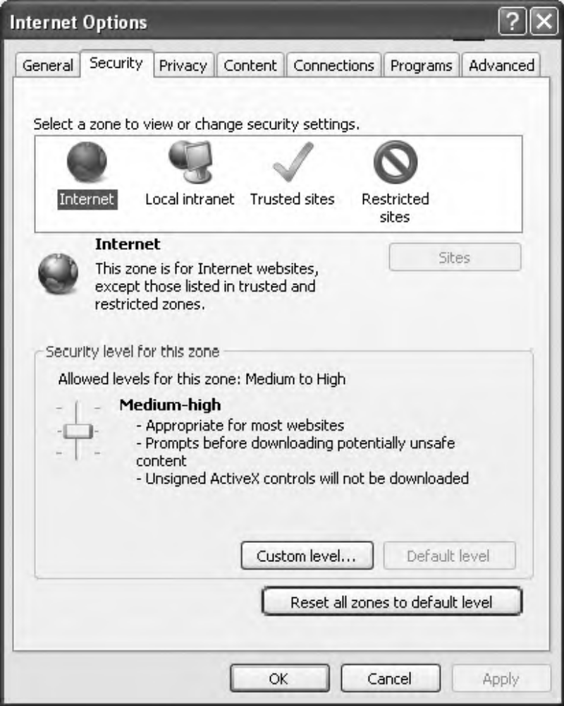
Zones
A zone is an individual area of the network that has been configured with a specific trust level. Firewalls are ideal devices to regulate the flow of traffic between zones.

Slide 14
Intrusion-Detection and –Prevention Systems
A great tool for doing network detective work is known as an Intrusion Detection System (IDS).
Firewalls are designed to block nasty traffic from entering your network, but IDS is more of an auditing tool: It keeps track of all activity on your network so you can see if someone has been trespassing. Because IDSs are a fairly new technology, people are busy developing ways to combine IDS technology with existing firewalls.

Slide 15
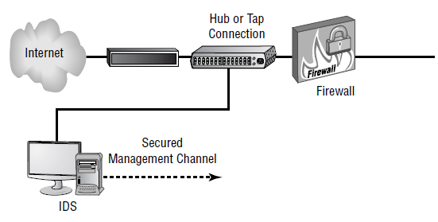
Network-Based IDS
By far the most common implementation of a detection system is a network-based IDS (NIDS), where the IDS system is a separate device attached to the network via a machine like a switch or directly via a tap.

Slide 16
Host-Based IDS
In a host-based IDS (HIDS), software runs on one computer to detect abnormalities on that system alone by monitoring applications, system logs, and event logs—not by directly monitoring network traffic.

Slide 17
VPN Concentrators
A VPN concentrator is a device that creates remote access for virtual private networks (VPNs) either for users logging in remotely or for a large site-to-site VPN.
Encryption for a remote-access VPN through a concentrator is usually handled by Internet Protocol Security (IPSec) or by Secure Sockets Layer (SSL), and user authentication can be achieved via Microsoft’s Active Directory, Kerberos, Remote Authentication Dial In User Service (RADIUS), Rivest, Shamir, and Adleman (RSA), and digital certificates.

Slide 18
Secure and Unsecure Application Protocols
Unsecure Protocols
  Telnet
  HTTP
  FTP
  SNMP
Secure Protocols
  SSH
  HTTPS
  SFTP
  SCP
  SNMPv3

